Slide 1
Phased Array GPR Simulations
Team 24
Presenter: Coy Coburn
Partners: Michael Turner, Daniel Miller, Tyler Castro

Slide 2
GPR Overview
Control Unit
Objective: To map underground root systems
The transmitter will pulse a signal to penetrate the ground up to 1 meter.
The receiver will take the reflected signal.
The control unit will display the created radar image and record an image log.
The main feature of this GPR system is the phased array antennas.
Transmitter Circuit
Receiver Circuit
Transmitter Antenna
Direct Signal
Receiver Antenna
Transmitted Pulse
Reflected Pulse

Slide 3
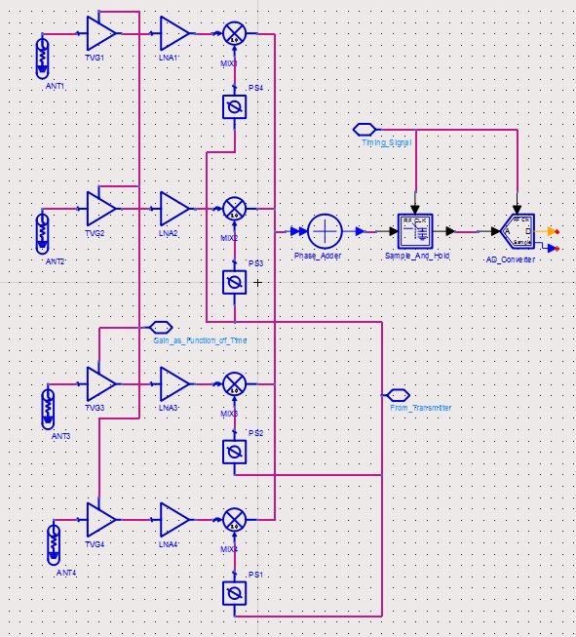
Receiver Circuit
Implementation
The Time Varying Gain is included before the Low Noise Amplifier.
The TVG weighting must be chosen depending on the soil type.
Each reflection picked up by the antennas are amplified before mixed to simplify design.

Slide 4
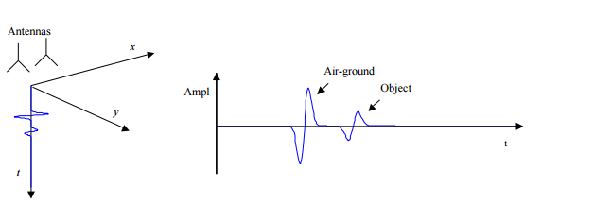
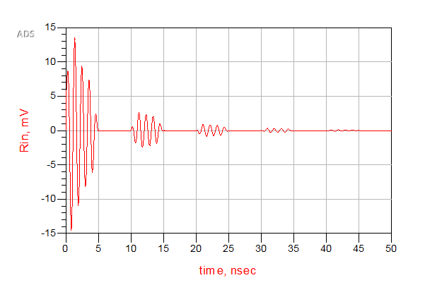
Radar Display
Below is an example of the expected signal to be received.
This test signal is made by pulsing a decaying sine wave.
The medium (ground) usually does not return much reflection after entering the ground.
[1] Scheers, Bart taken from http://www.sic.rma.ac.be/~scheers/Papers/chapter2.pdf

Slide 5
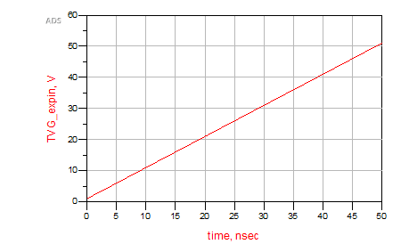
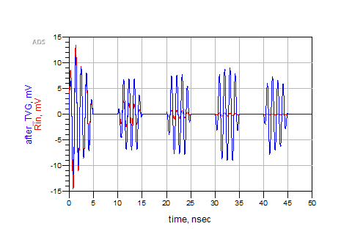
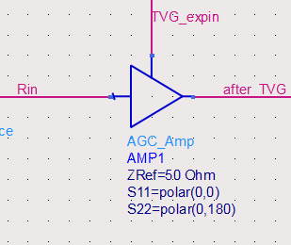
Time Varying Gain
Farther distance leads to a weaker reflection
A time varying gain is utilized to amplify weaker reflections
TVG is very similar to the Automatic Gain Control

Slide 6
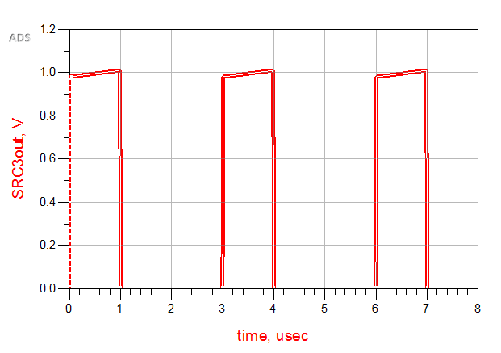
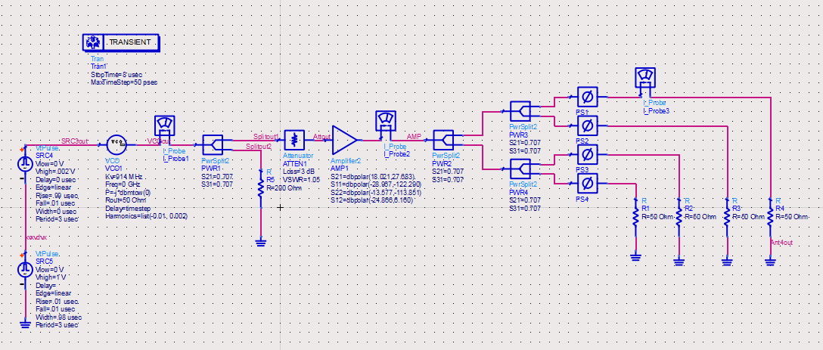
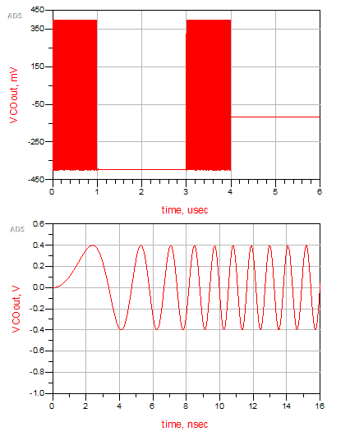
Transmitter with Chirp Simulations
Input signal into the VCO

Slide 7
Citations
[1] Bart Scheers, “Ultra-Wideband Ground Penetrating Radar, with Application to the Detection of Anti Personnel Landmines,” Ph.D. dissertation, Dept. Elect. Eng, Catholic Univ. of Louvain, Louvain-la-Neuve, Belgium, 2001.
[2] C. Allen , “Radar Pulse Compression ,” 2004. [Online]. Available at: https://www.ittc.ku.edu/workshops/Summer2004Lectures/Radar_Pulse_Compression.pdf. [Accessed: 2015]
[3] Cedric Martel, “Modelling and Design of Antennas for Ground-Penetrating Radar Systems ,” Ph.D. dissertation, Dept. Elect. Eng, Univ. of Surrey, Guildford, United Kingdom, 2002.
[4] “Ground Penetrating RADAR (GPR) (After Basson 2000) Introduction,” GPR theory, 2007. [Online]. Available at: http://www.geo-sense.com/gprmore.htm. [Accessed: Dec-2015].

